Slide 1

CHAPTER 6
SET THEORY
Copyright © Cengage Learning. All rights reserved.

Slide 2

6.1
Set Theory: Definitions and the Element
Method of Proof
Copyright © Cengage Learning. All rights reserved.

Slide 3
Set Theory: Definitions and the Element Method of Proof
The words set and element are undefined terms of set theory just as sentence, true, and false are undefined terms of logic.
The founder of set theory, Georg Cantor, suggested imagining a set as a “collection into a whole M of definite and separate objects of our intuition or our thought.
These objects are called the elements of M.” Cantor used the letter M because it is the first letter of the German word for set: Menge.

Slide 4
Set Theory: Definitions and the Element Method of Proof
Following the spirit of Cantor’s notation (though not the letter), let S denote a set and a an element of S.
Then, as indicated in Section 1.2, a ∈ S means that a is an element of S, a ∉ S means that a is not an element of S, {1, 2, 3} refers to the set whose elements are 1, 2, and 3, and {1, 2, 3, … } refers to the set of all positive integers.

Slide 5

Set Theory: Definitions and the Element Method of Proof
If S is a set and P(x) is a property that elements of S may or may not satisfy, then a set A may be defined by writing
which is read “A is the set of all x in S such that P of x.”

Slide 6
Subsets: Proof and Disproof

Slide 7


Subsets: Proof and Disproof
We defined what it means for a set A to be a subset of the set B. Here we rewrite the definition as a formal universal conditional statement:
The negation is, therefore, existential:

Slide 8

Subsets: Proof and Disproof
We know that a proper subset of a set is a subset that is not equal to its containing set. That is:

Slide 9
Example 6.1.1 – Testing Whether One Set Is a Subset of Another
Let A = {1} and B = {1, {1}}.
a. Is A ⊆ B?
b. If so, is A a proper subset of B?

Slide 10
Example 6.1.1 – Solution
a. Because A = {1}, A has only one element—namely, the symbol 1. This element is also one of the elements in set B. Hence every element in A is in B, and so A ⊆ B.
Note A set like {1}, with just one element, is called
a singleton set.
b. B has two distinct elements, the symbol 1 and the set {1} whose only element is 1. Since 1 ≠ {1}, the set {1} is not an element of A, and so there is an element of B that is not an element of A. Hence A is a proper subset of B.

Slide 11
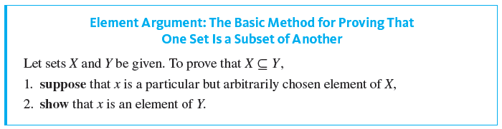
Subsets: Proof and Disproof

Slide 12
Example 6.1.2 – Proving and Disproving Subset Relations
Define sets A and B as follows:
a. Outline a proof that A ⊆ B.
b. Prove that A ⊆ B.
c. Disprove that B ⊆ A.

Slide 13
Example 6.1.2 – Solution
a. Proof Outline:
Starting Point: Suppose x is a particular but arbitrarily chosen element of A.
To Show: Therefore, x is an element of B.
b. Proof:
Suppose x is a particular but arbitrarily chosen element
of A.
[We must show that x ∈ B. By definition of B, this means we must show that x = 3 · (some integer).]

Slide 14
Example 6.1.2 – Solution
continued
By definition of A, there is an integer, say r, such that
x = 6r + 12.
[Given that x = 6r + 12, can we express x as 3 · (some integer)? That is, does 6r + 12 = 3 · (some integer)? Yes, 6r + 12 = 3 · (2r + 4).]
Let s = 2r + 4.
[We must check that s is an integer.]

Slide 15
Example 6.1.2 – Solution
continued
Then s is an integer because products and sums of integers are integers, and so 3s ∈ B by definition of B.
[Now we must check that x = 3s.]
Also 3s = 3(2r + 4) = 6r + 12 = x,
Thus, by definition of B, x is an element of B,
[as was to be shown].

Slide 16
Example 6.1.2 – Solution
continued
c. To disprove a statement means to show that it is false. And to show that B ⊆ A is false, you must find an element of B that is not an element of A.
By the definitions of A and B, this means that you must find an integer x of the form 3 · (some integer) that cannot be written in the form 6 · (some integer) + 12.
A little experimentation reveals that various numbers work. For instance, you could let x = 3.

Slide 17
Example 6.1.2 – Solution
continued
Then x ∈ B because 3 = 3 · 1, but x ∉ A because there is no integer r such that 3 = 6r + 12. For if there were such an integer, then
6r + 12 = 3
by assumption
2r + 4 = 1
by dividing both sides by 3
2r = −3
by subtracting 4 from both sides
r = −3 ∕ 2
by dividing both sides by 2.

Slide 18
Example 6.1.2 – Solution
continued
But −3 ∕ 2 is not an integer. Thus 3 ∈ B whereas 3 ∉ A, and so B ⊈ A.

Slide 19
Set Equality

Slide 20
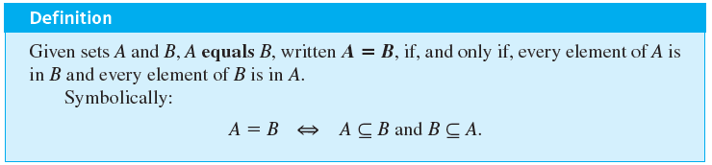
Set Equality
This version of the definition of equality implies the following:
To know that a set A equals a set B, you must know
that A ⊆ B and you must also know that B ⊆ A.

Slide 21
Example 6.1.3 – Set Equality
Define sets A and B as follows:
Is A = B?

Slide 22
Example 6.1.3 – Solution
Yes. To prove this, both subset relations A ⊆ B and B ⊆ A must be proved.
Part 1, Proof That A ⊆ B:
Suppose x is a particular but arbitrarily chosen element of A.
[We must show that x ∈ B. By definition of B, this means we must show that x = 2 · (some integer) − 2.]
By definition of A, there is an integer, say a, such that x = 2a.

Slide 23
Example 6.1.3 – Solution
[Given that x = 2a, can x also be expressed as 2 · (some integer) − 2? In other words, is there an integer—say, b—such that 2a = 2b − 2? Solve for b to obtain b = (2a + 2) ∕ 2 = a + 1. Check to see if this works.]
Let b = a + 1.
[First check that b is an integer.]
Then b is an integer because it is a sum of integers.
[Then check that x = 2b − 2.]
Also, 2b − 2 = 2(a + 1) − 2 = 2a + 2 − 2 = 2a = x.

Slide 24
Example 6.1.3 – Solution
continued
Thus, by definition of B, x is an element of B
[as was to be shown].
Part 2, Proof That B ⊆ A:
Suppose x is a particular but arbitrarily chosen element of B.
[We must show that x ∈ A. By definition of A, this means we must show that x = 2 · (some integer).]
By definition of B, there is an integer b such that x = 2b − 2.

Slide 25
Example 6.1.3 – Solution
continued
[Given that x = 2b − 2, can x also be expressed as 2 · (some integer)? That is, is there an integer— say, a—such that 2b − 2 = 2a? Solve for a to obtain a = b − 1. Check to see if this works.]
Let a = b − 1.
[First check that a is an integer.]
We know that a is an integer because it is a difference
of integers.
[Then check that x = 2a.]

Slide 26
Example 6.1.3 – Solution
continued
By substitution, 2a = 2(b − 1) = 2b − 2 = x.
Thus, by definition of A, x is an element of A,
[as was to be shown].

Slide 27
Venn Diagrams

Slide 28
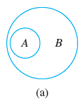
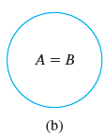
Venn Diagrams
If sets A and B are represented as regions in the plane, relationships between A and B can be represented by pictures called Venn diagrams.
For instance, the relationship A ⊆ B can be pictured in one of two ways, as shown in Figure 6.1.1.
A ⊆ B
Figure 6.1.1

Slide 29
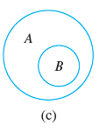
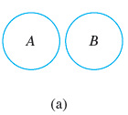
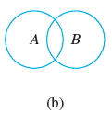
Venn Diagrams
The relationship A ⊄ B can be represented in three different ways, as shown in Figure 6.1.2.
A ⊄ B
Figure 6.1.2

Slide 30
Example 6.1.4 – Relations among Sets of Numbers
Since Z, Q, and R denote the sets of integers, rational numbers, and real numbers, respectively, then Z is a subset of Q because every integer is rational (any integer n can be
written in the form
), and Q is a subset of R because every rational number is real (any rational number can be represented as a length on the number line).
Z is a proper subset of Q because there are rational numbers that are not integers (for example,
), and Q is a proper subset of R because there are real numbers that are not rational (for example,
).

Slide 31
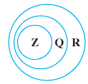
Example 6.1.4 – Relations among Sets of Numbers
continued
These relationships are shown diagrammatically in Figure 6.1.3.
Figure 6.1.3

Slide 32
Operations on Sets

Slide 33
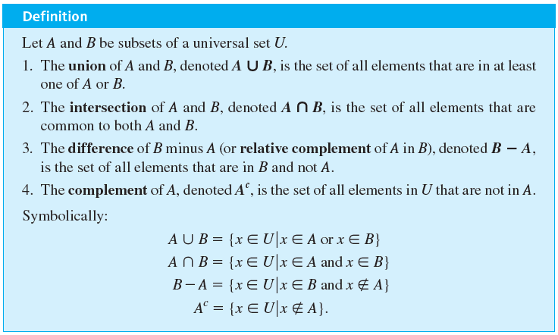
Operations on Sets

Slide 34
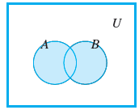
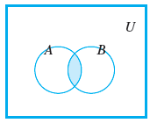
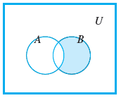
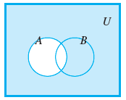
Operations on Sets
Venn diagram representations for union, intersection, difference, and complement are shown in Figure 6.1.4.
Shaded region
represents A ∪ B.
Shaded region
represents A ∩ B.
Shaded region
represents B − A.
Shaded region
represents
Figure 6.1.4

Slide 35
Example 6.1.5 – Unions, Intersections, Differences, and Complements
Let the universal set be the set U = {a, b, c, d, e, f, g}, and let A = {a, c, e, g} and B = {d, e, f, g}.
Find A ∪ B, A ∩ B, B − A, and

Slide 36

Example 6.1.5 – Solution
A ∪ B = {a, c, d, e, f, g}
A ∩ B = {e, g}
B − A = {d, f}
= {b, d, f }

Slide 37
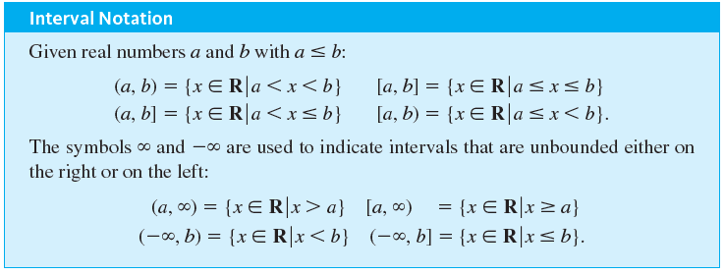
Operations on Sets
There is a convenient notation for subsets of real numbers that are intervals.

Slide 38
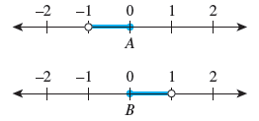
Example 6.1.6 – An Example with Intervals
Let the universal set be R, the set of all real numbers, and let
These sets are shown on the number lines below.
Find A ∪ B, A ∩ B, B − A, and

Slide 39



Example 6.1.6 – Solution

Slide 40

Example 6.1.6 – Solution
continued
by definition of the double inequality
by De Morgan’s law

Slide 41
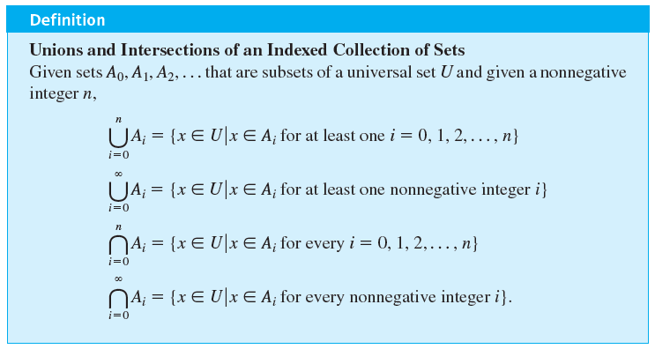
Operations on Sets

Slide 42


Example 6.1.7 – Finding Unions and Intersections of More than Two Sets
For each positive integer i , let
a. Find A ₁ ∪ A ₂ ∪ A ₃ and A ₁ ∩ A ₂ ∩ A ₃.
b. Find

Slide 43

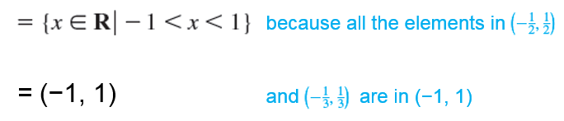
Example 6.1.7 – Solution
a.

Slide 44


Example 6.1.7 – Solution
continued

Slide 45


Example 6.1.7 – Solution
continued
b.
because all the elements in every interval
= (−1, 1)
are in (−1, 1)
= {0}
because the only element in every interval is 0

Slide 46
The Empty Set

Slide 47
The Empty Set
There is only one set with no elements. Because it is unique, we can give it a special name. We call it the empty set (or null set) and denote it by the symbol
Thus

Slide 48
Example 6.1.8 – A Set with No Elements
Describe the following sets.
a.
b.

Slide 49
Example 6.1.8 – Solution
a. We know that a < x < b means that a < x and x < b. So D consists of all real numbers that are both greater than 3 and less than 2.
Since there are no such numbers, D has no elements and thus D =
b. E is the set of all integers that are both greater than 2 and less than 3. Since no integers satisfy this condition, E has no elements, and so E =

Slide 50
Partitions of Sets

Slide 51
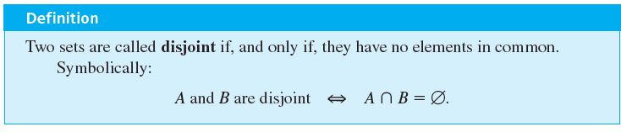
Partitions of Sets
In many applications of set theory, sets are divided into nonoverlapping (or disjoint) pieces. Such a division is called a partition.

Slide 52
Example 6.1.9 – Disjoint Sets
Let A = {1, 3, 5} and B = {2, 4, 6}. Are A and B disjoint?

Slide 53
Example 6.1.9 – Solution
Yes. By inspection A and B have no elements in common, or, in other words, {1, 3, 5} ∩ {2, 4, 6} =

Slide 54
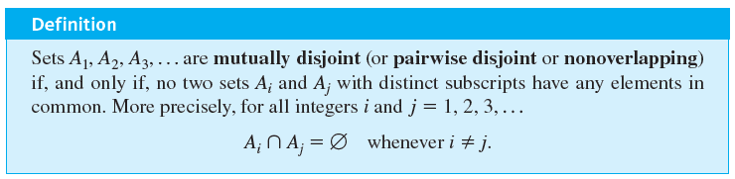
Partitions of Sets

Slide 55
Example 6.1.10 – Mutually Disjoint Sets
a. Let A ₁ = {3, 5}, A ₂ = {1, 4, 6}, and A ₃ = {2}. Are A ₁, A ₂, and A ₃ mutually disjoint?
b. Let B ₁ = {2, 4, 6}, B ₂ = {3, 7}, and B ₃ = {4, 5}. Are B ₁, B ₂, and B ₃ mutually disjoint?

Slide 56
Example 6.1.10 – Solution
a. Yes. A ₁ and A ₂ have no elements in common, A ₁ and A ₃ have no elements in common, and A ₂ and A ₃ have no elements in common.
b. No. B ₁ and B ₃ both contain 4.

Slide 57
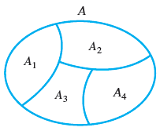
Partitions of Sets
Suppose A, A ₁, A ₂, A ₃, and A ₄ are the sets of points represented by the regions shown in Figure 6.1.5.
A Partition of a Set
Figure 6.1.5

Slide 58
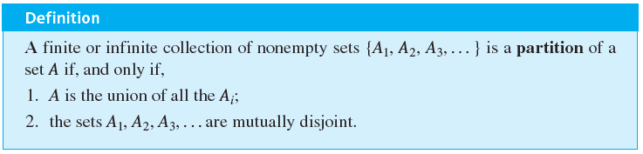
Partitions of Sets
Then A₁, A₂, A₃, and A₄ are subsets of A, and A = A₁ ∪ A₂ ∪ A₃ ∪ A₄. Suppose further that boundaries are assigned to the regions representing A₁, A₂, A₃, and A₄ in such a way that these sets are mutually disjoint. Then A is called a union of mutually disjoint subsets, and the collection of sets {A₁, A₂, A₃, A₄} is said to be a partition of A.

Slide 59

Example 6.1.11 – Partitions of Sets
a. Let A = {1, 2, 3, 4, 5, 6}, A₁ = {1, 2}, A₂ = {3, 4}, and A₃ = {5, 6}. Is {A₁, A₂, A₃} a partition of A?
b. Let Z be the set of all integers and let
Is {T₀, T₁, T₂} a partition of Z?

Slide 60
Example 6.1.11 – Solution
a. Yes. By inspection, A = A₁ ∪ A₂ ∪ A₃ and the sets A₁, A₂, and A₃ are mutually disjoint.
b. Yes. By the quotient-remainder theorem, every integer n can be represented in exactly one of the three forms
n = 3k or n = 3k + 1 or n = 3k + 2,
for some integer k. This implies that no integer can be in any two of the sets T₀, T₁, or T₂. So T₀, T₁, and T₂ are mutually disjoint. The theorem also implies that every integer is in one of the sets T₀, T₁, or T₂. So Z = T₀ ∪ T₁ ∪ T₂.

Slide 61
Power Sets

Slide 62

Power Sets
There are various situations in which it is useful to consider the set of all subsets of a particular set. The power set axiom guarantees that this is a set.

Slide 63
Example 6.1.12 – Power Set of a Set
Find the power set of the set {x, y}. That is, find

Slide 64



Example 6.1.12 – Solution
is the set of all subsets of {x, y}. In the next section we will show that
is a subset of every set, and so
Also any set is a subset of itself, so
The only other subsets of {x, y} are {x} and {y}, so

Slide 65
An Algorithm to Check Whether One Set Is a Subset of Another (Optional)

Slide 66
An Algorithm to Check Whether One Set Is a Subset of Another (Optional)
Order the elements of both sets and successively compare each element of the first set with each element of the second set. If some element of the first set is not found to equal any element of the second, then the first set is not a subset of the second.
But if each element of the first set is found to equal an element of the second set, then the first set is a subset of the second. The following algorithm formalizes this reasoning.

Slide 67
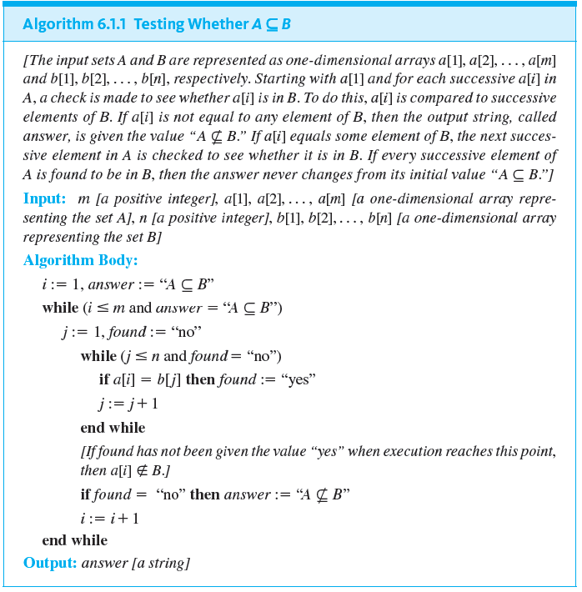
An Algorithm to Check Whether One Set Is a Subset of Another (Optional)

Slide 68
Example 6.1.13 – Tracing Algorithm 6.1.1
Trace the action of Algorithm 6.1.1 on the variables i, j, found, and answer for m = 3, n = 4, and sets A and B represented as the arrays a[1] = u, a[2] = v, a[3] = w, b[1] = w, b[2] = x, b[3] = y, and b[4] = u.

Slide 69
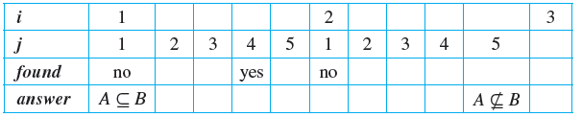
Example 6.1.13 – Solution

